Slide 1
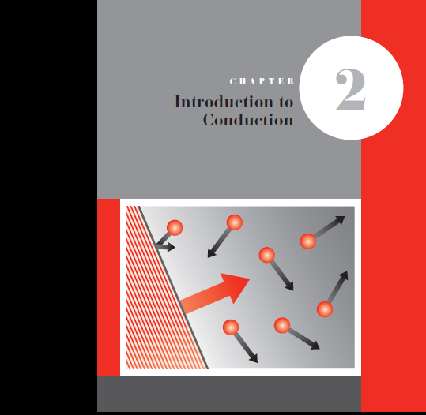

Slide 2
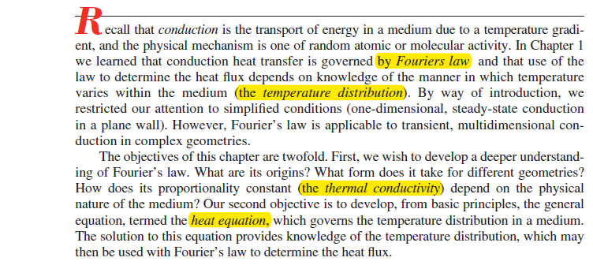
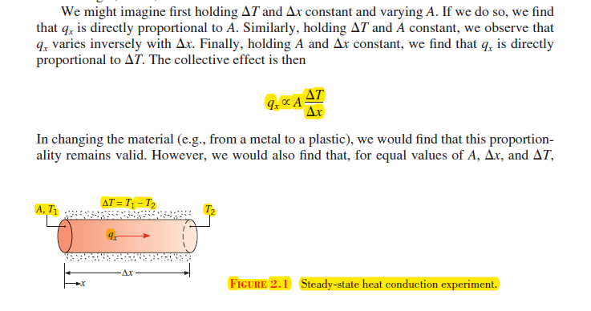

Slide 3
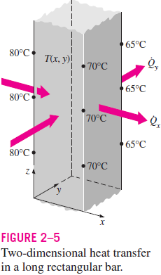

Slide 4
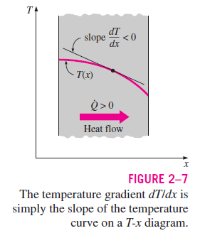
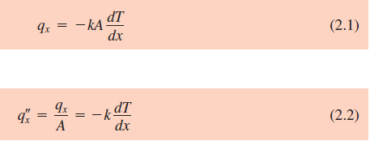

Slide 5
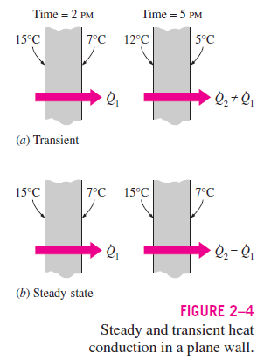
Heat transfer problems are often classified as being steady (also called steady state) or transient (also called unsteady). The term steady implies no change with time at any point within the medium, while transient implies variation with time or time dependence. Therefore, the temperature or heat flux remains unchanged with time during steady heat transfer through a medium at any location, although both quantities may vary from one location to another

Slide 7
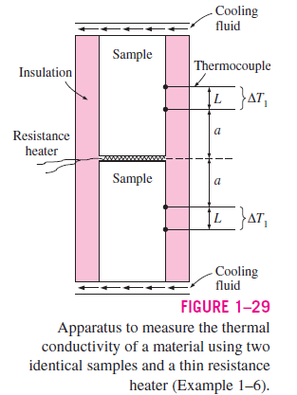

Slide 8
In heat transfer analysis, the ratio of the thermal conductivity to the heat capacity is an important property termed the thermal diffusivity , which has units of m2/s:
It measures the ability of a material to conduct thermal energy relative to its ability to store thermal energy. Materials of large will respond quickly to changes in their thermal environment, whereas materials of small will respond more sluggishly, taking longer to reach a new equilibrium condition.

Slide 9
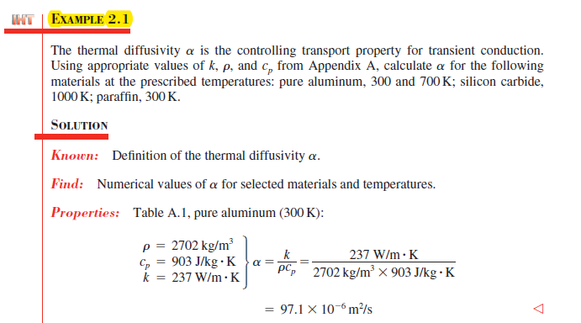

Slide 10
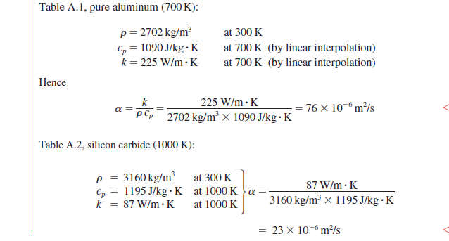

Slide 11
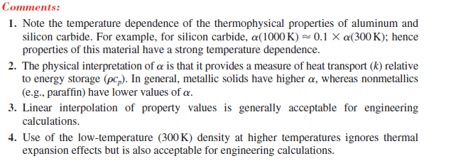

Slide 12
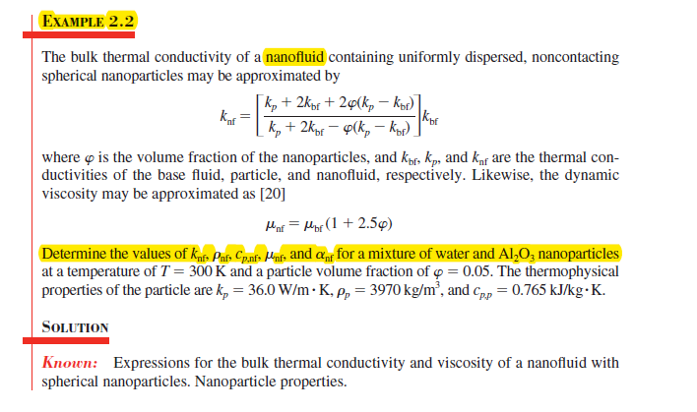

Slide 14
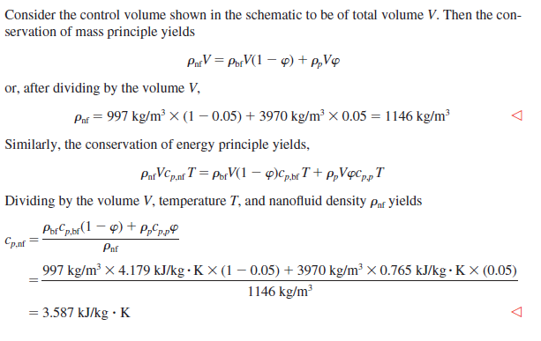

Slide 15
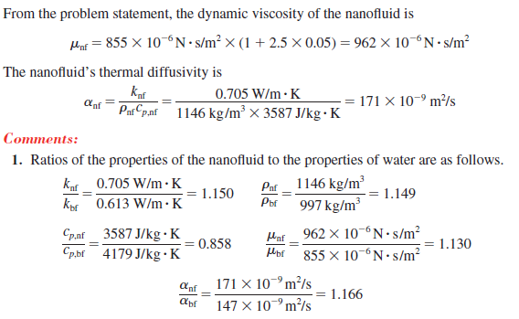
The relatively large thermal conductivity and thermal diffusivity of the nanofluid
enhance heat transfer rates in some applications.

Slide 16
A major objective in a conduction analysis is to determine the temperature field in a
medium resulting from conditions imposed on its boundaries. That is, we wish to know
the temperature distribution, which represents how temperature varies with position in the medium. Once this distribution is known, the conduction heat flux at any point in the medium or on its surface may be computed from Fourier’s law.
The temperature distribution could also be used to optimize the thickness of an insulating material or to determine the compatibility of special coatings or adhesives used with the material.

Slide 17
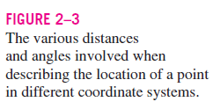
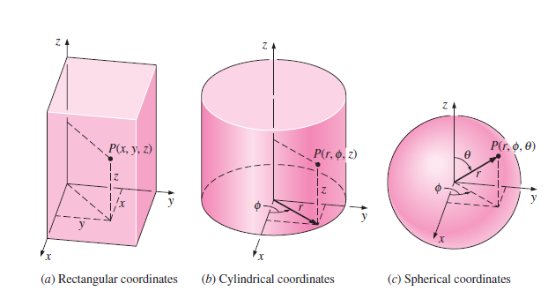

Slide 18
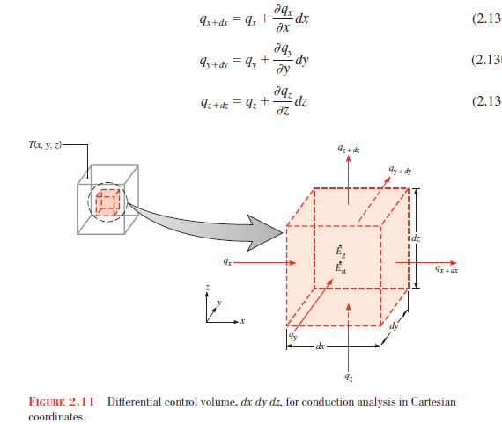
Consider a homogeneous medium within which there is no bulk motion (advection) and
the temperature distribution
T(x, y, z) is expressed in Cartesian coordinates. Following the
methodology of applying conservation of energy (Section 1.3.1), we first define an infinitesimally small (differential) control volume, dx dy dz, as shown in Figure 2.11. Choosing to formulate the first law at an instant of time, the second step is to consider the energy processes that are relevant to this control volume. In the absence of motion (or with uniform motion), there are no changes in mechanical energy and no work being done on the system. Only thermal forms of energy need be considered.

Slide 19
energy source
energy storage

Slide 20
Substituting Equations 2.18 into Equation 2.17 and dividing out the dimensions of the control volume (dx dy dz), we obtain Heat diffusion equation
Net transfer of thermal energy into the
control volume (inflow-outflow)
Thermal energy
generation
Change in thermal
energy storage
under steady-state conditions,
Moreover, if the heat transfer is one-dimensional (e.g., in the x-direction) and there is no energy generation, Equation 2.22 reduces to

Slide 21
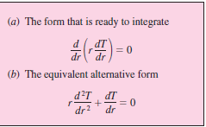
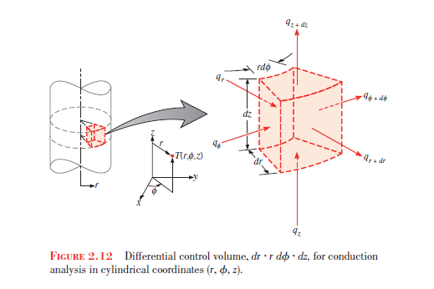
Cylindrical Coordinates

Slide 22
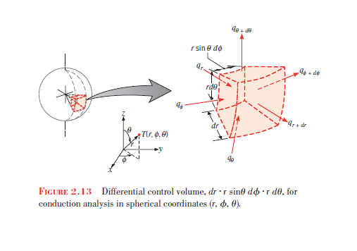
Spherical Coordinates

Slide 23
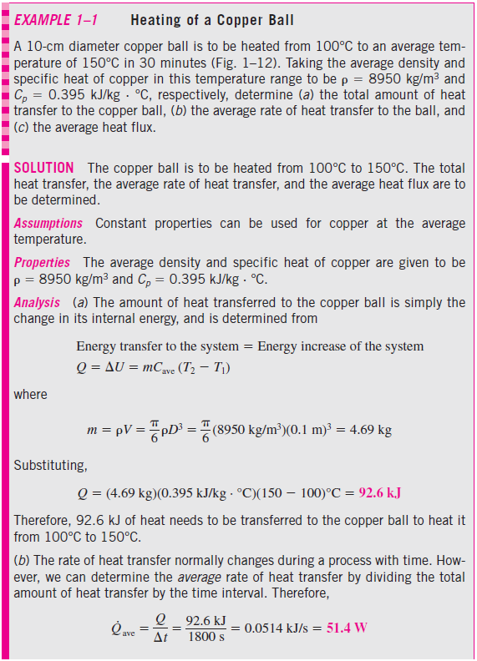
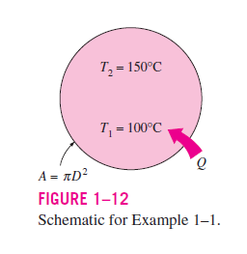

Slide 24
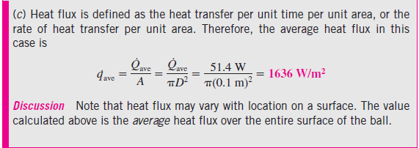

Slide 25
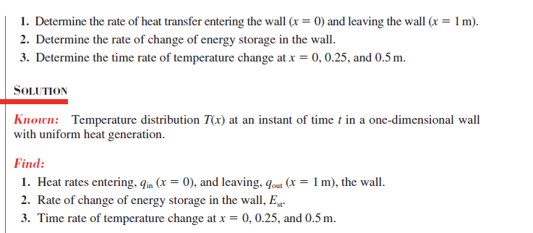

Slide 26
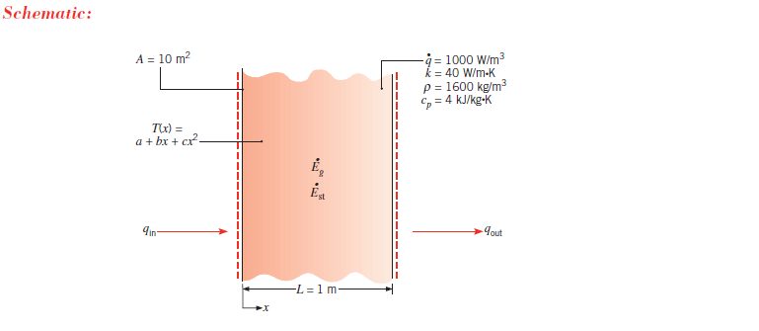

Slide 28
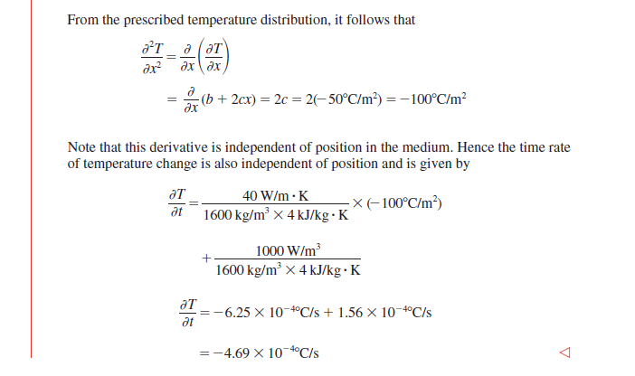

Slide 29
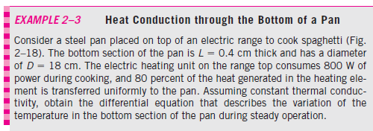
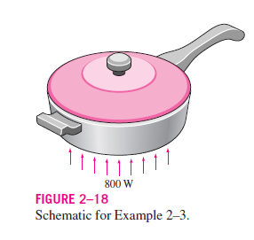
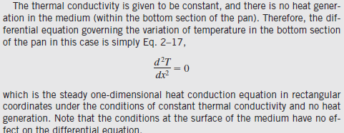

Slide 30
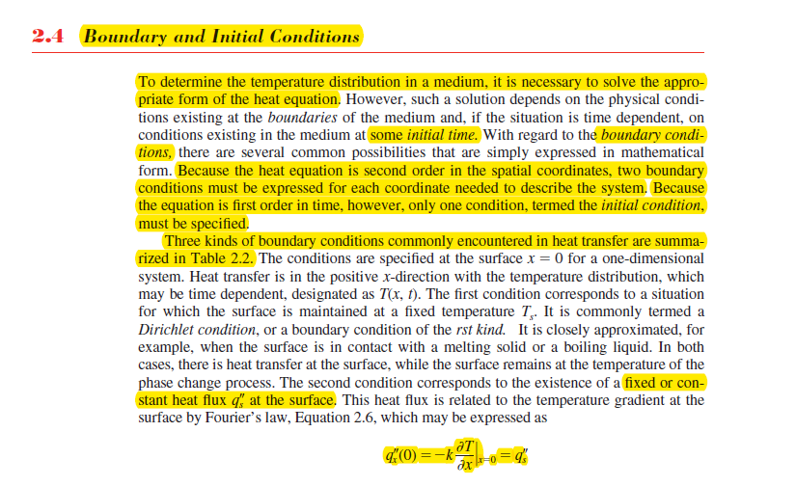

Slide 31
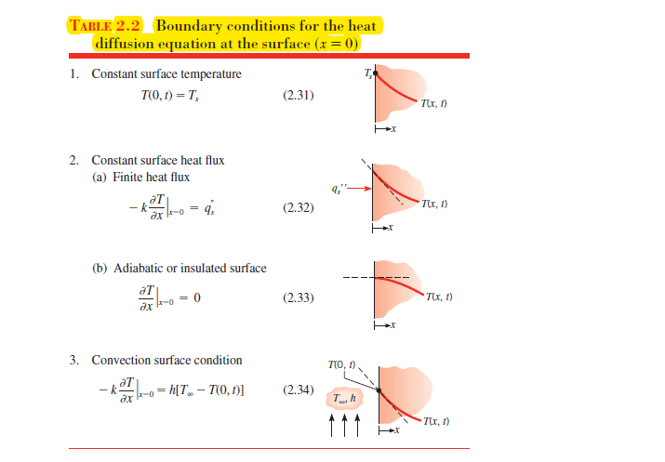

Slide 32
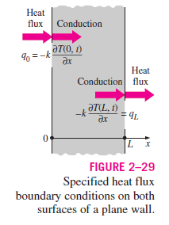
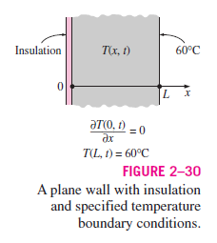
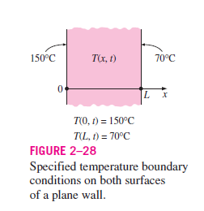
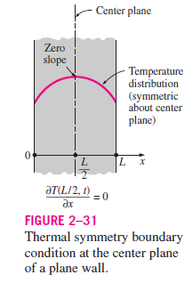

Slide 34
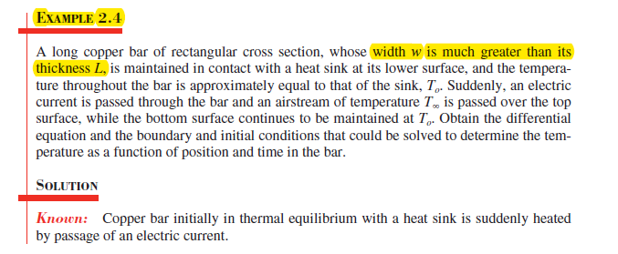
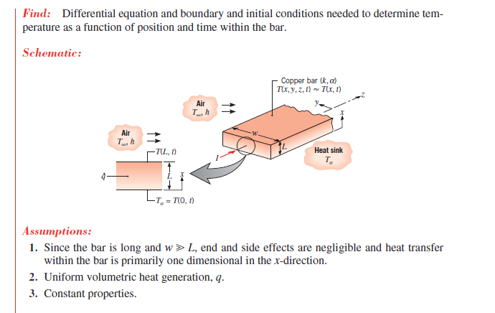

Slide 35
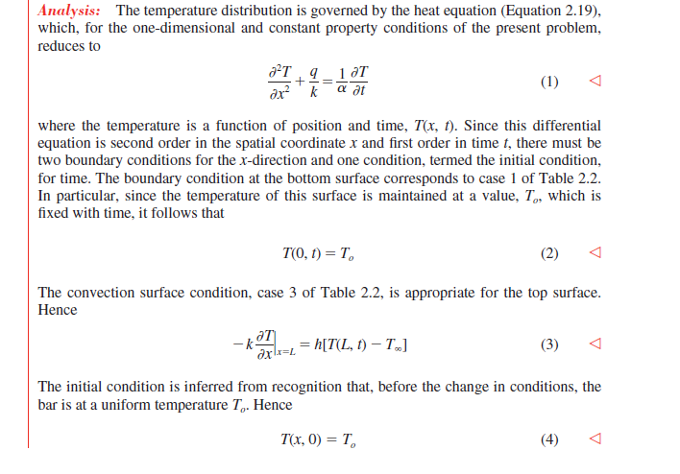

Slide 36
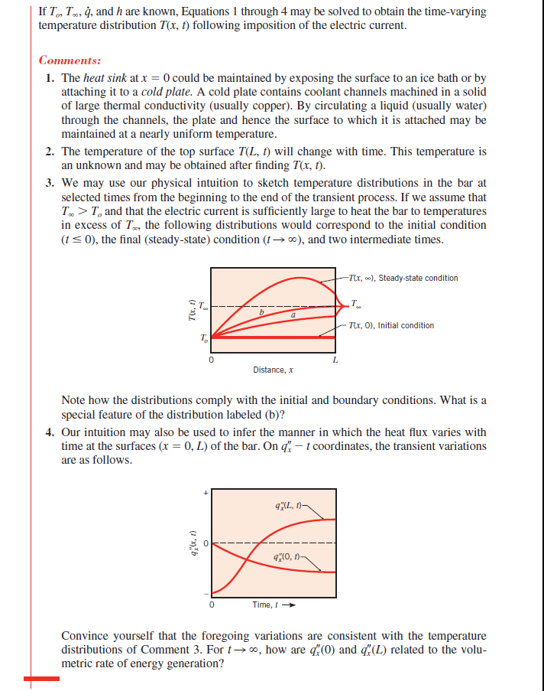

Slide 37
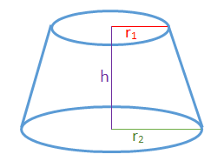

Slide 38
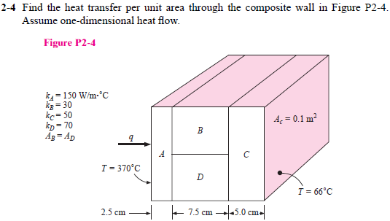

Slide 39
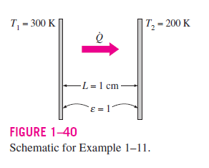
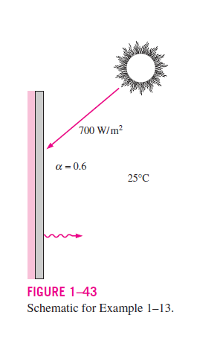
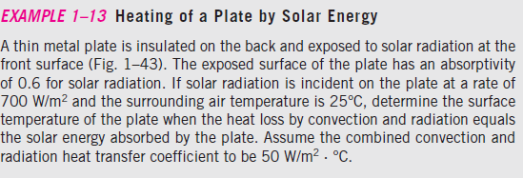

Slide 40
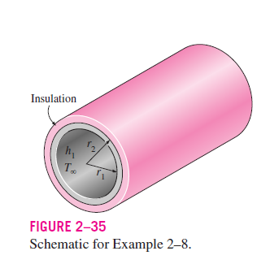
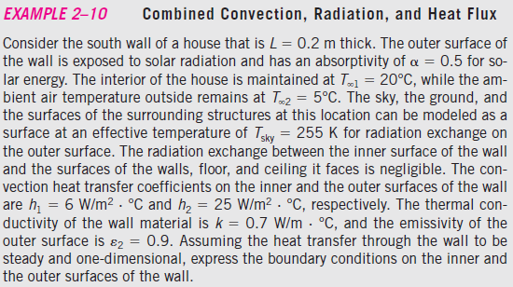
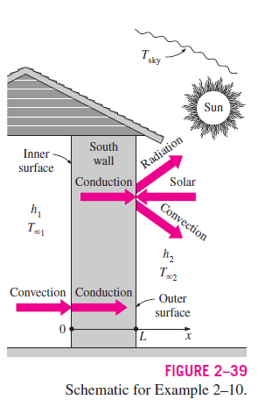

Slide 41
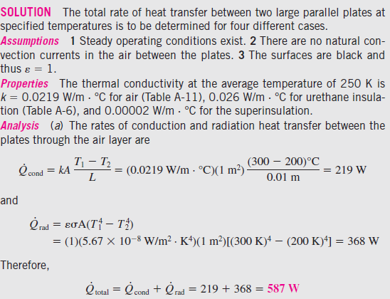
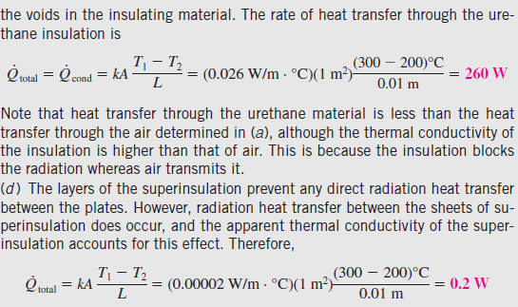

Slide 42
